Slide 3
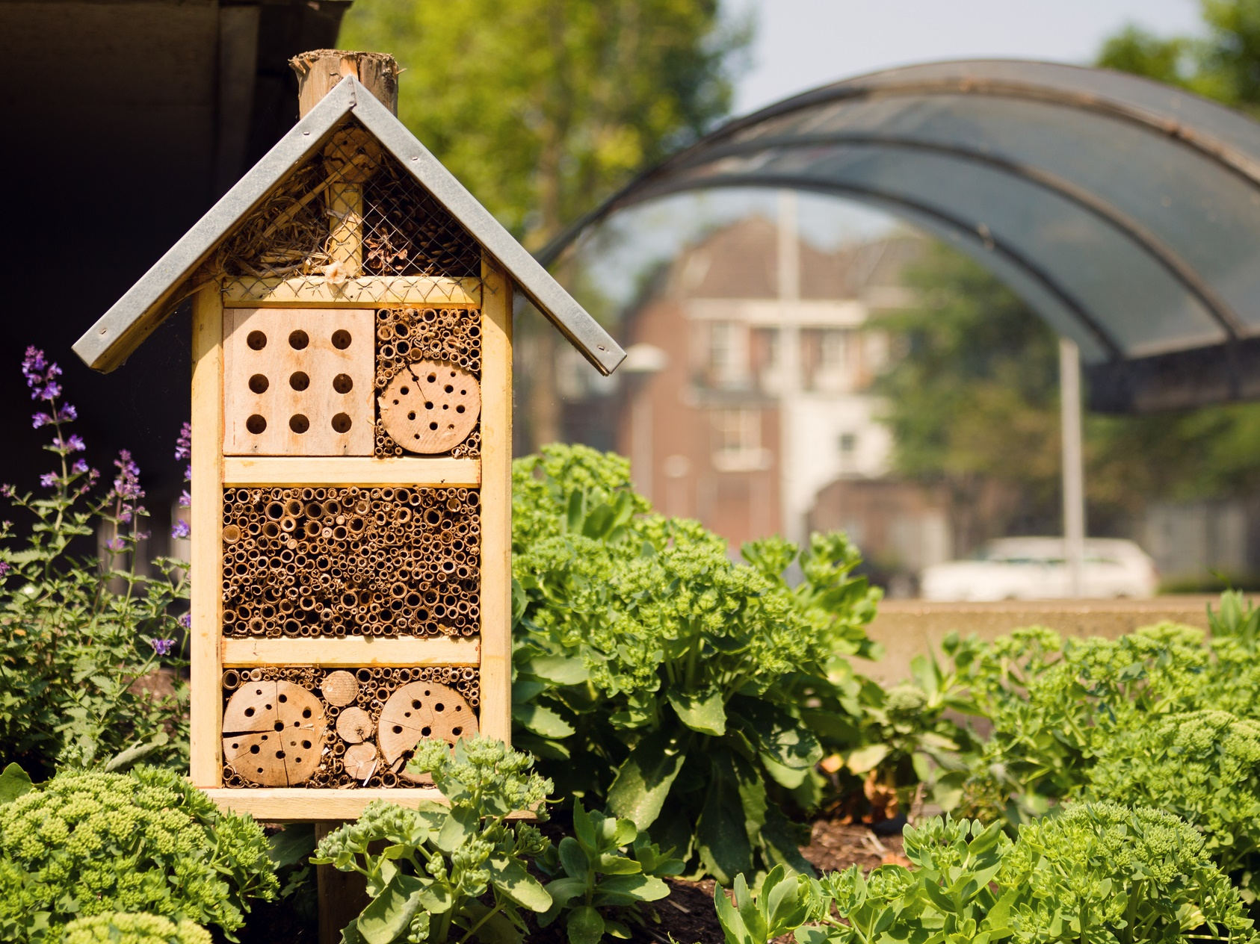
Today’s VoteTopic:
Would you like more wildlife in your towns and cities?
UNCRC Article 24:
Health, water, food, environment
UN SDG 15:
Life on
land
VfS Key Theme 3:
Environment & climate change
Notes:
Images
iStock

Slide 4
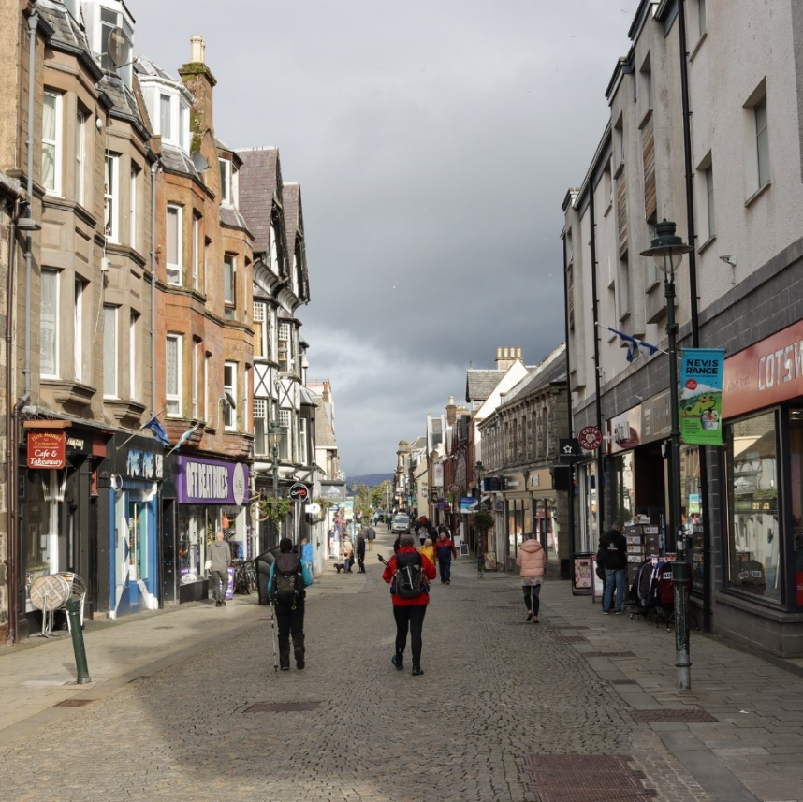
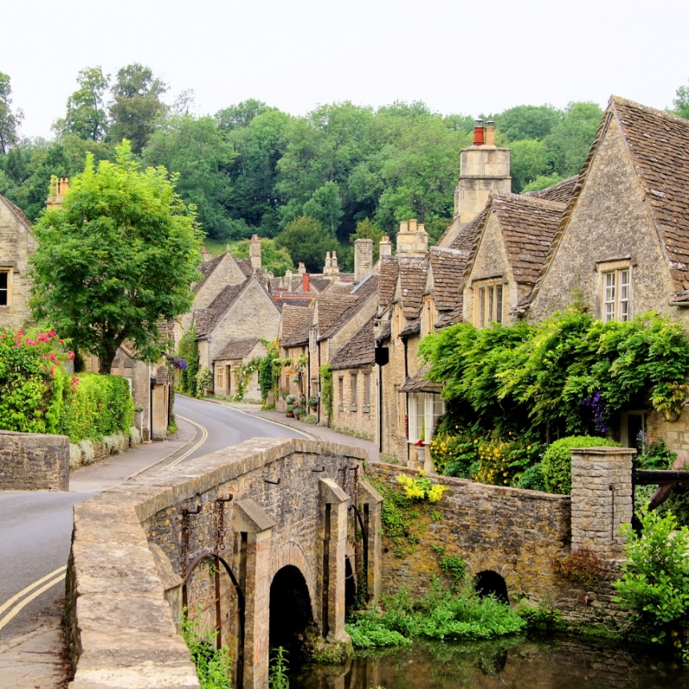
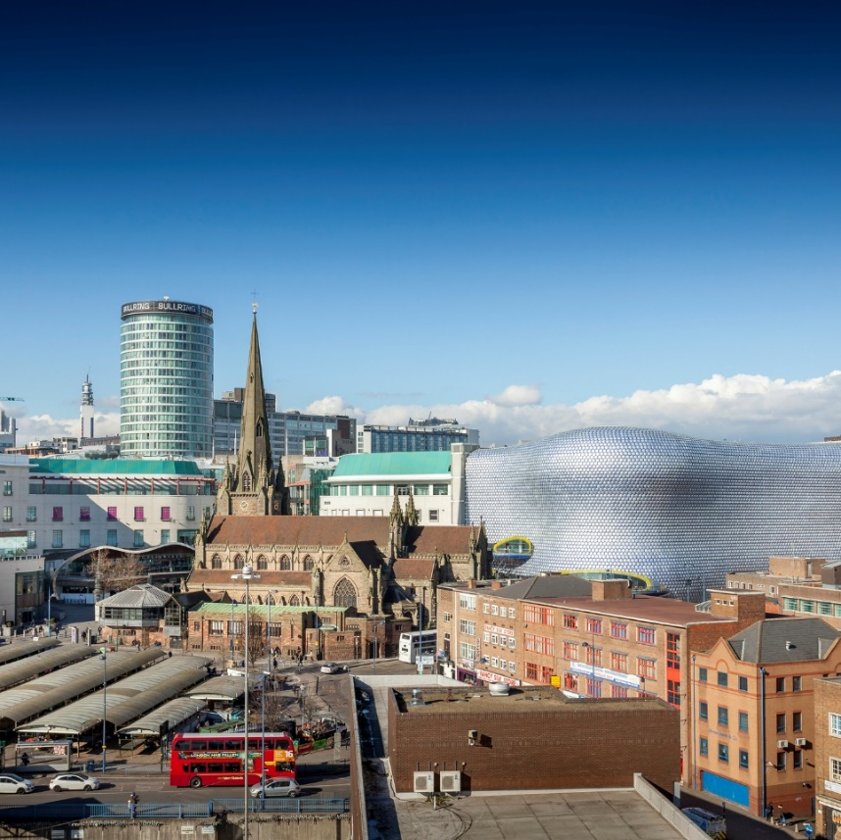
1
What’s the difference?
Pair activity (2-3 mins)
Talk to your partner and see if you can match these words to their pictures.
Village
City
Town
Notes:
Images
iStock
Microsoft Office 365

Slide 5
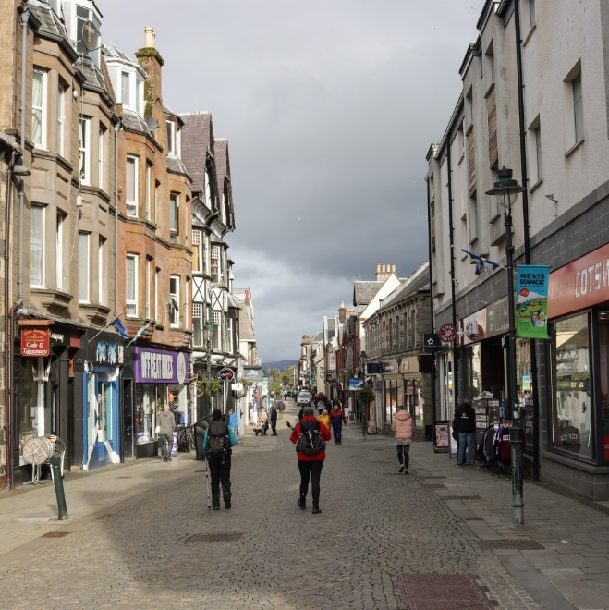
1
What’s the difference?
Village
Town
City
A small number of houses and other places (like small shops or a local school), often in the countryside. Hundreds of people might live there.
A medium-sized place with lots of houses, shops, some workplaces, cinemas and restaurants. Thousands of people might live there.
A large place with many houses, larger shops, many workplaces and a cathedral. Hundreds of thousands of people might live there.
Notes:
Images
iStock
Microsoft Office 365
References
https://dictionary.cambridge.org/dictionary/english/village
https://dictionary.cambridge.org/dictionary/english/town
https://dictionary.cambridge.org/dictionary/english/city
https://www.bbc.co.uk/teach/class-clips-video/geography-ks1--ks2-cities-towns-villages/zjn492p#:~:text=A%20town%20is%20a%20larger,And%20often%20a%20town%20hall

Slide 6
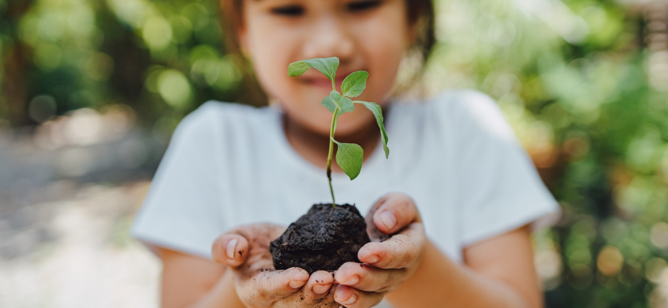
2
Why are we talking about this?
VotesforSchools has teamed up with Eco-Schools to support their Healthy Summer Toolkit.
This lesson gives you the chance to be heard by people around the UK who are in charge of looking after our villages, towns and cities!
Notes:
Images
iStock
Courtesy of Eco-Schools
References
https://www.earthday.org/
https://climatekids.nasa.gov/kids-guide-to-climate-change/

Slide 7
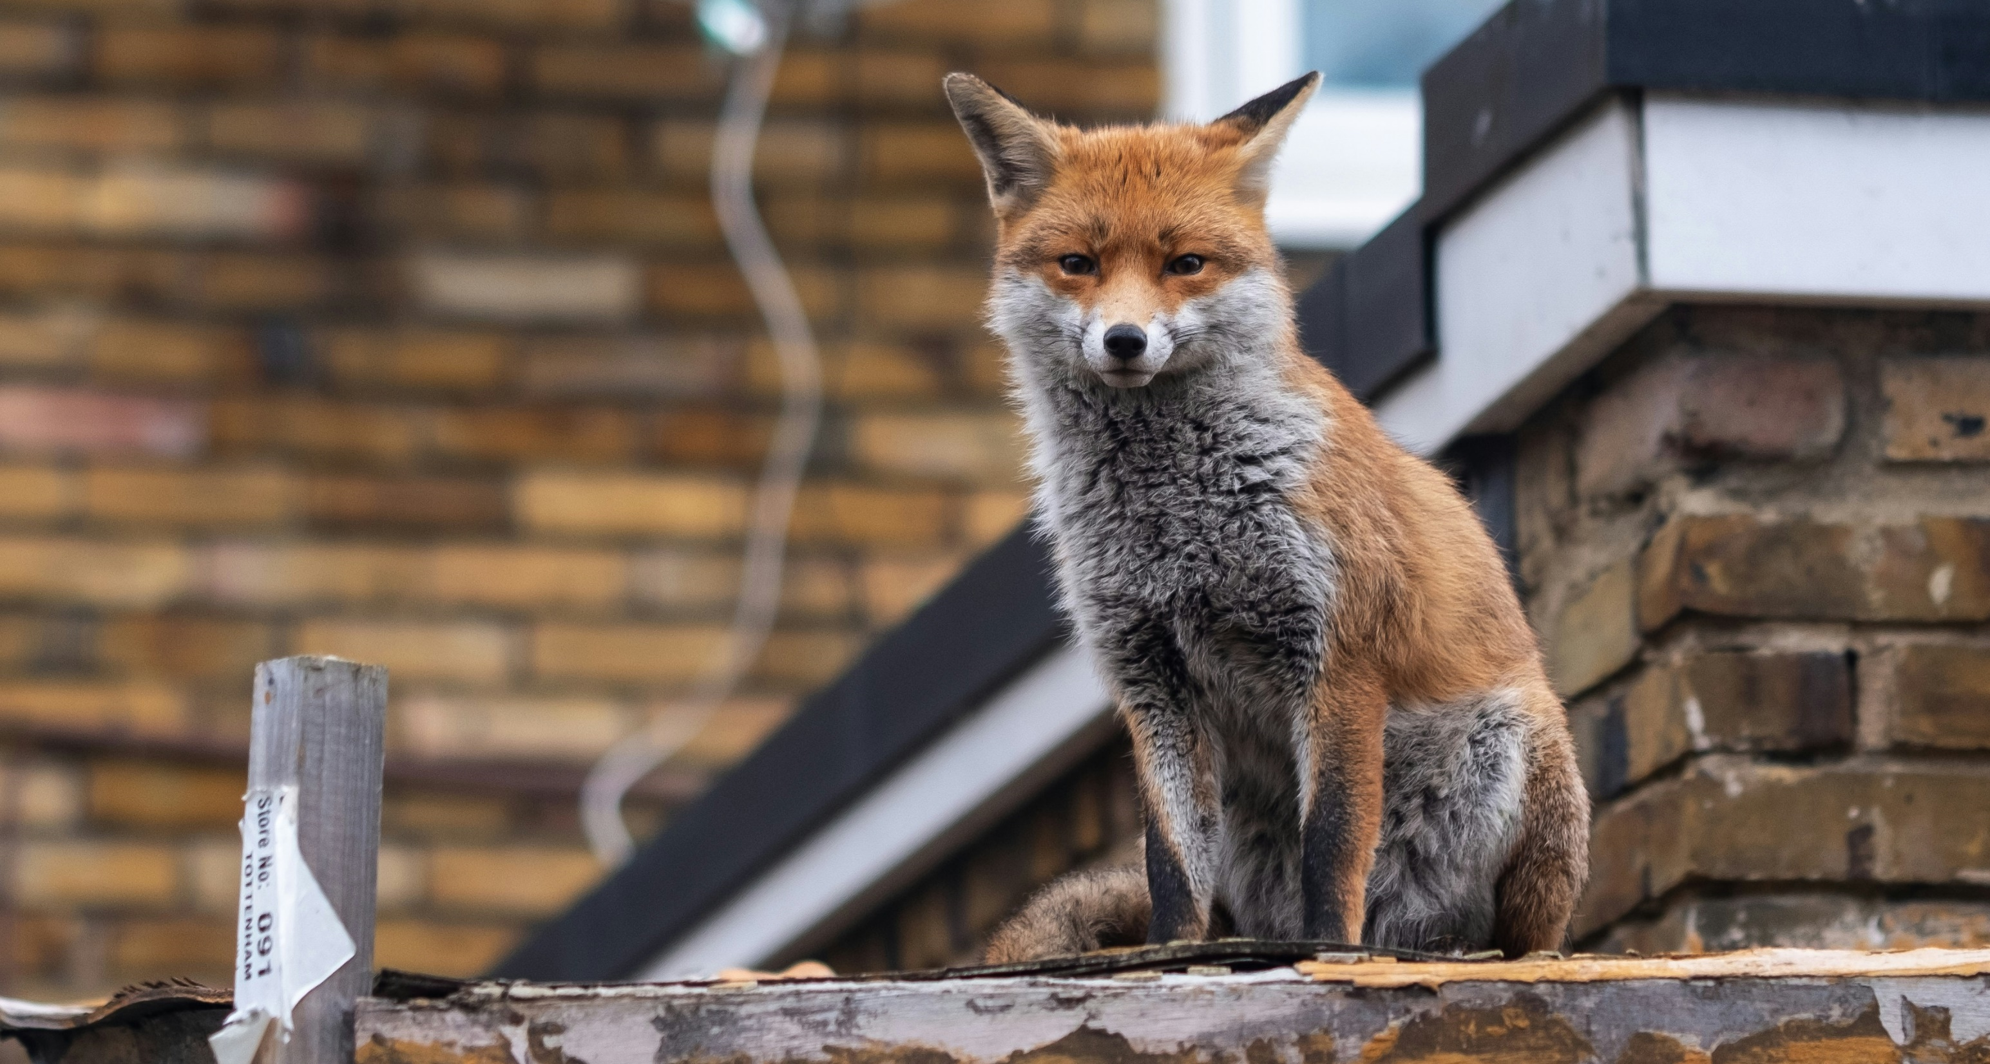
2
Why are we talking about this?
Many of us live in towns and cities. You might not be used to seeing lots of different wildlife in a town or city.
Individual reflection (1-2 mins)
How do you feel when you see wildlife, like animals, birds or insects?
Notes:
Images
Unsplash

Slide 8
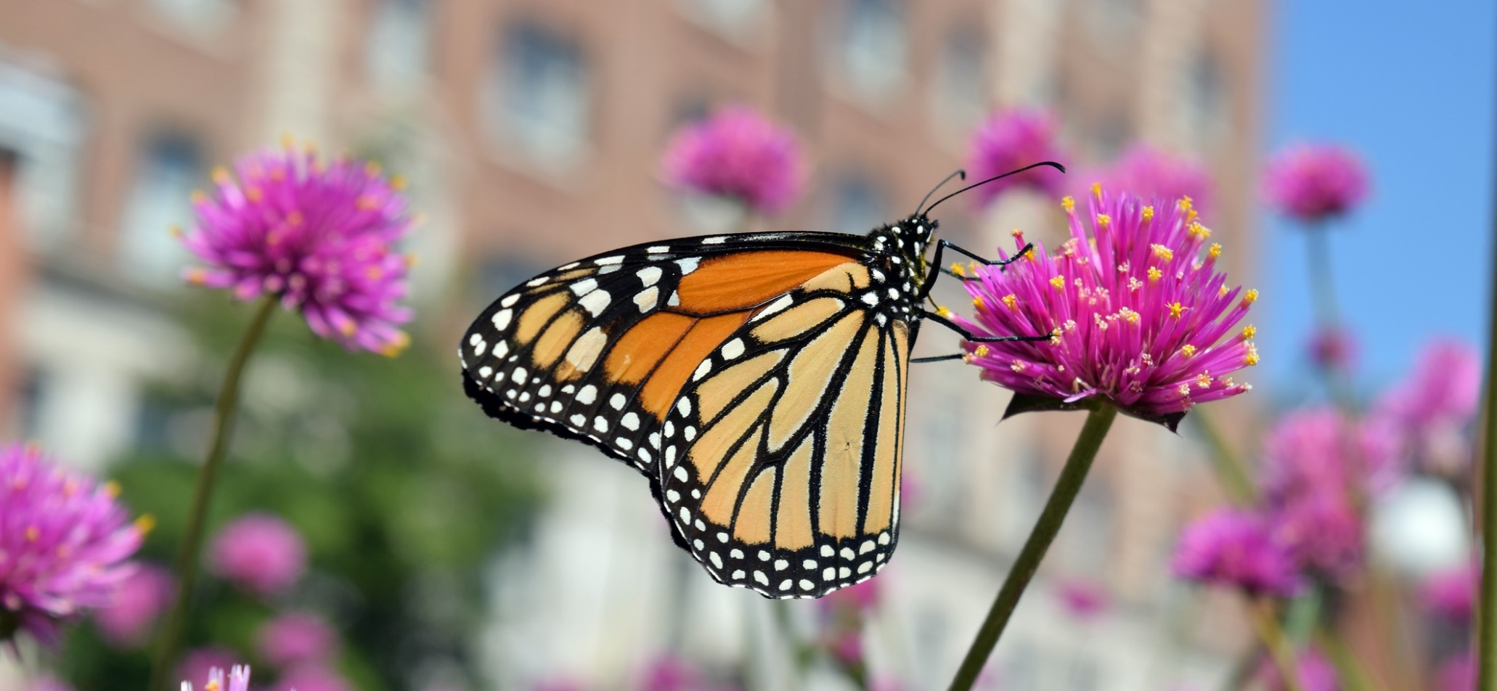
2
Why are we talking about this?
However, there are lots of different kinds of wildlife that live alongside humans in the hidden corners of towns and cities across the UK.
But is there enough? Would you like more wildlife in your towns and cities? Let’s decide today.
Notes:
Images
iStock
References
https://www.wildlifetrusts.org/where_to_see_urban_wildlife

Slide 9
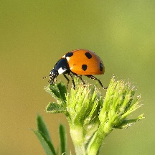
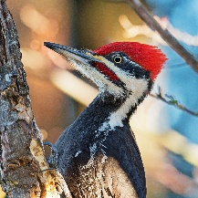
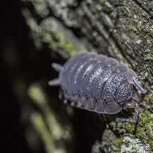
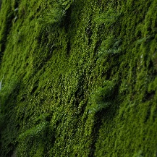
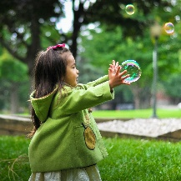
3
It’s wild out there…
Pair activity (3-5 mins)
All living things on our planet are connected. Now we’re going to think about a tree and the different living things that are in it. Talk to your partner to share your guesses about each living thing under the magnifying glass.
Notes:
Images
Unsplash
Pixabay

Slide 10
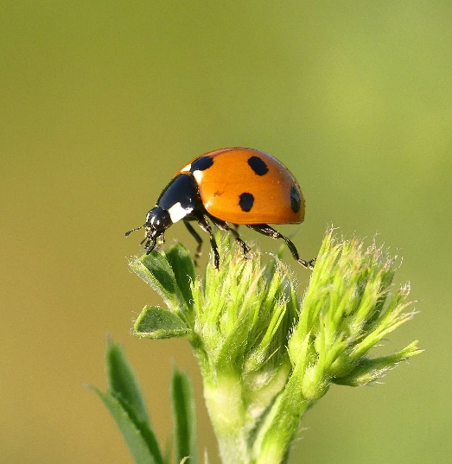
3
It’s wild out there…
What is this creature?
This is a ladybird. They eat small insects which feed on tree leaves. Ladybirds also lay eggs on the leaves.
Notes:
Images
Unsplash
Pixabay
References
https://www.coleoptera.org.uk/coccinellidae/lots-about

Slide 11
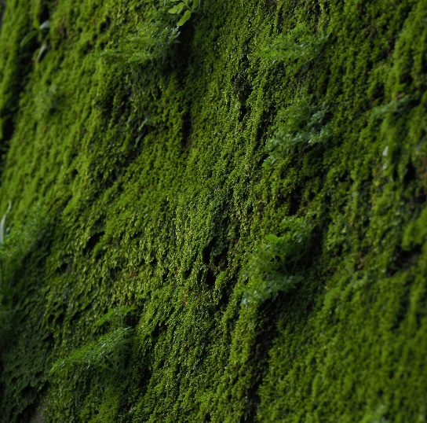
3
It’s wild out there…
This is moss. It is like a sponge. It helps to soak up rainfall and it is a home for tiny insects.
What could this green stuff be?
Notes:
Images
Unsplash
Pixabay
References
https://www.kew.org/read-and-watch/moss

Slide 12
3
It’s wild out there…
Have you ever seen
(or heard) a bird like this?
This is a woodpecker. They eat insects including ladybirds and woodlice.
You might have heard one tapping on wood before!
Notes:
Images
Unsplash
Pixabay
References
https://www.wildlifetrusts.org/where-see-wildlife/where-see-spring-wildlife/woodpeckers

Slide 13
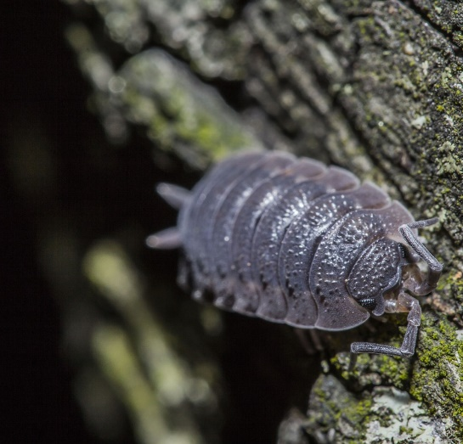
3
It’s wild out there…
This is a woodlouse. It eats dead leaves.
This helps to create fresh soil which helps the tree grow.
What is the name of this insect?
Notes:
Images
Unsplash
Pixabay
References
https://www.discoverwildlife.com/animal-facts/insects-invertebrates/facts-about-common-rough-woodlouse

Slide 14
3
It’s wild out there…
This is a human. Humans use trees for shelter and shade. They also use the wood to make timber, paper and cardboard.
What can we see here?
Notes:
Images
Unsplash
Pixabay

Slide 15
4
Bee informed
Whole class activity (4-6 mins)
Now you will hear some information about wildlife in the UK.
If you think the information is true, buzz like a bee. If you think the information is false, squeak like a mouse.
Buzz!
Squeak!
Notes:
Images
iStock
Microsoft Fluent Emoji

Slide 16
4
Bee informed
Buzz for true, squeak for false!
Buzz!
Squeak!
The UK has more than 70,000 known types of wildlife.
This is true!
This includes animals, plants and insects.
Notes:
Images
iStock
Microsoft Fluent Emoji
References
https://royalsociety.org/news-resources/projects/biodiversity/biodiversity-in-the-uk/

Slide 17
4
Bee informed
Buzz for true, squeak for false!
Buzz!
Squeak!
This is true!
This means animals and insects have fewer types of food to eat.
There are fewer different types of plants than there used to be in the UK.
Notes:
Images
iStock
Microsoft Fluent Emoji
References
https://www.london.gov.uk/programmes-strategies/environment-and-climate-change/parks-green-spaces-and-biodiversity/biodiversity

Slide 18
4
Bee informed
Buzz for true, squeak for false!
Buzz!
Squeak!
This is false!
These insects do lots of important jobs helping plants to grow.
There are fewer bees, flies and moths than there used to be.
There are more bees, flies and moths than there used to be.
Notes:
Images
iStock
Microsoft Fluent Emoji
References
https://stateofnature.org.uk/wp-content/uploads/2023/09/TP25999-State-of-Nature-main-report_2023_FULL-DOC-v12.pdf

Slide 19
4
Bee informed
Buzz for true, squeak for false!
Buzz!
Squeak!
This is false!
Research shows that plants can help people feel better in their mind and their body.
Lots of plants in a town or city can make people feel more worried.
Lots of plants in a town or city can make people feel less worried.
Notes:
Images
iStock
Microsoft Fluent Emoji
References
https://www.tomorrow.city/how-does-biodiversity-benefit-human-health/

Slide 20
4
Bee informed
Buzz!
Buzz for true, squeak for false!
Squeak!
The sound of birdsong and leaves blowing in the wind can help people feel happier.
This is true!
Research shows that the sounds of nature can help people to relax.
Notes:
Images
iStock
Microsoft Fluent Emoji
References
https://www.tomorrow.city/how-does-biodiversity-benefit-human-health/

Slide 21
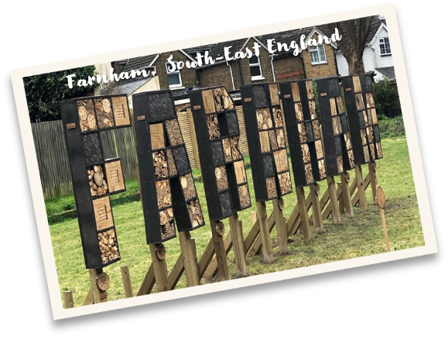
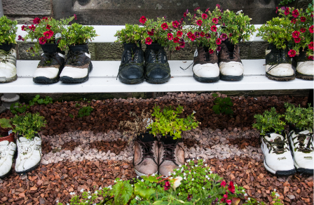
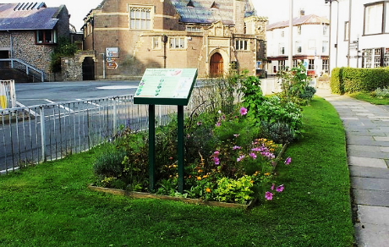
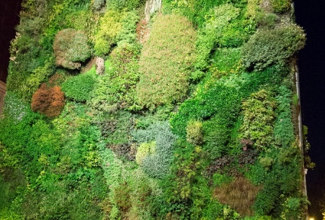
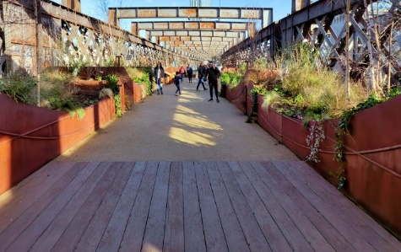
5
BiodiverCITIES
Whole class activity (5-8 mins)
On the next few slides, you will see some examples from towns and cities all over the UK where people are encouraging more wildlife to live there. Give a thumbs up if there is room for this in your nearest town or city and a thumbs down if you think there is no room.
Newcastle, North-East England
Crediton, South-West England
Conwy, north wales
Manchester
North-West England
Notes:
Images
Microsoft Fluent Emoji
Unsplash
iStock
Canva
https://www.facebook.com/farnhamofficial
https://commons.wikimedia.org/wiki/File:Incredible_edible_-_geograph.org.uk_-_5552099.jpg
https://commons.wikimedia.org/wiki/File:National_Trust_%27Sky_Park%27,_Castlefield_Viaduct,_Manchester_(geograph_7417617).jpg
https://upload.wikimedia.org/wikipedia/commons/c/cd/Living_wall_%2818653257555%29.jpg

Slide 22
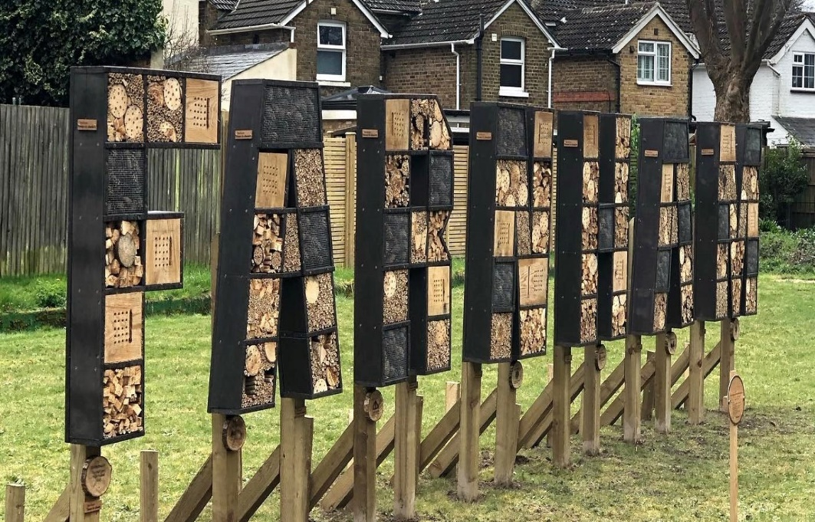
5
BiodiverCITIES
Farnham, South-East England
Is there room for this in your local town or city?
Farnham Town
Council has
created a bug
hotel which spells
out the name of
the town. Bug
hotels can help
increase the
number of
insects.
Mayor of Greater
Manchester,
56 Oxford Street,
MANCHESTER.
Notes:
Images
Microsoft Fluent Emoji
Unsplash
iStock
Canva
https://www.facebook.com/farnhamofficial
References
https://www.bbc.co.uk/news/articles/crg6ez9d9e7o
https://www.greatermanchester-ca.gov.uk/contact/

Slide 23
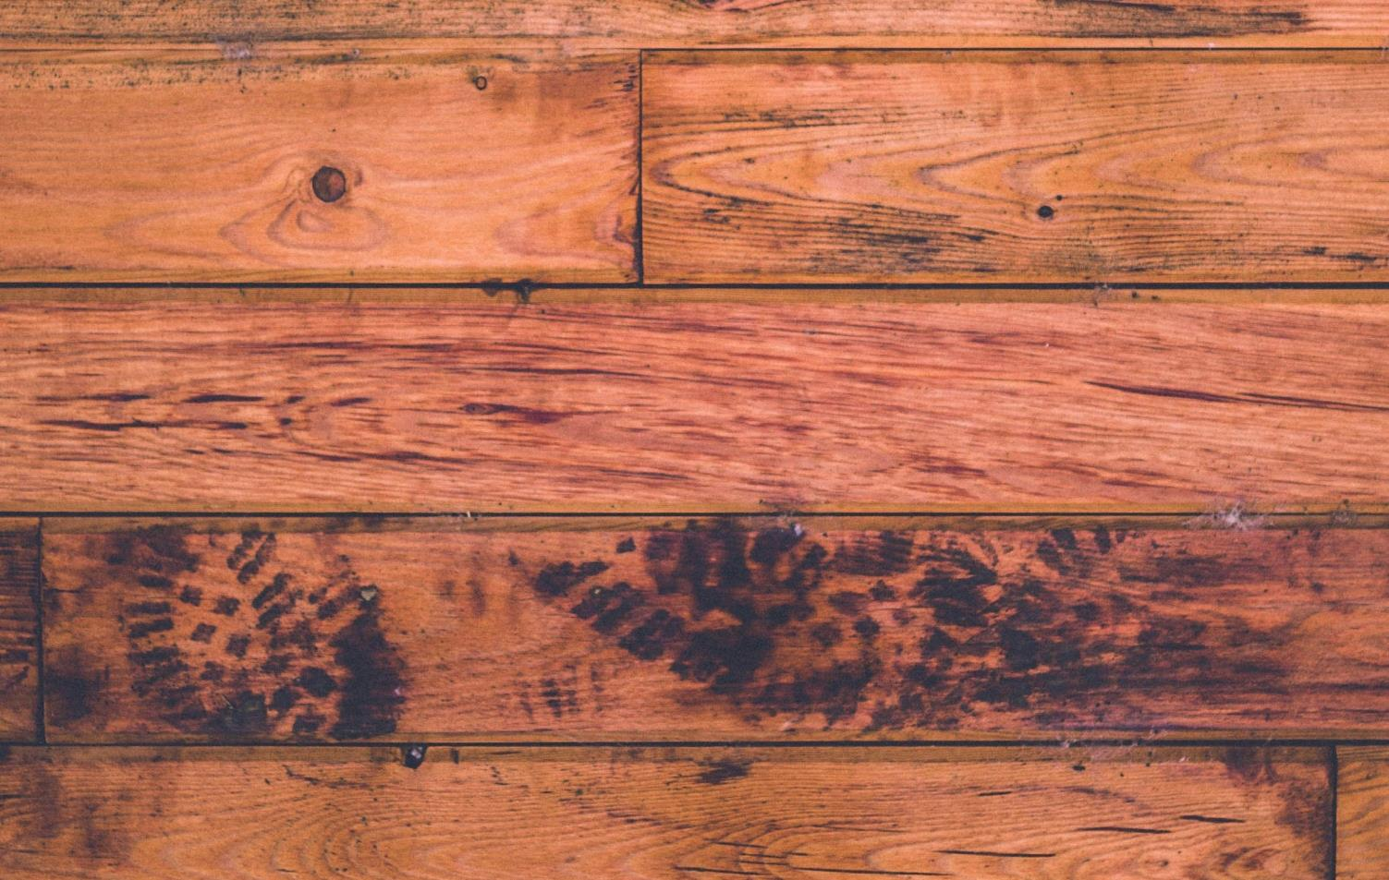
5
BiodiverCITIES
Is there room for this in your local town or city?
Hayward
Primary School
in Crediton has
made planters out
of old shoes,
which they grow
flowering plants
in to encourage
insect life at their
school.
Crediton, South-West England
Mayor of Leeds,
1st Floor West,
Civic Hall,
LEEDS.
Notes:
Images
Microsoft Fluent Emoji
Unsplash
iStock
Canva
References
https://www.creditoncourier.co.uk/news/recycled-shoe-planters-will-brighten-haywards-school-grounds-623236
https://www.leeds.gov.uk/councillors-and-democracy/lord-mayor

Slide 24
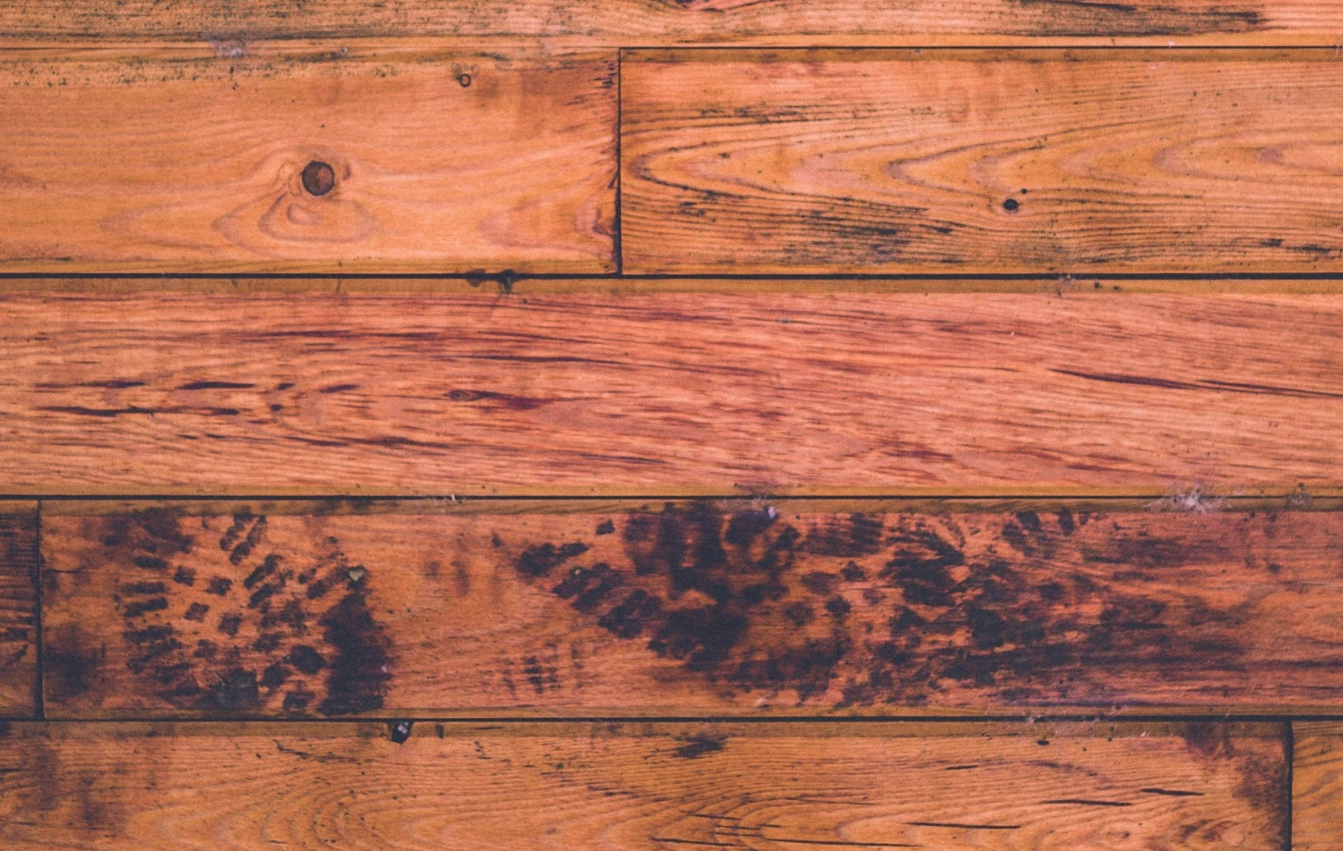
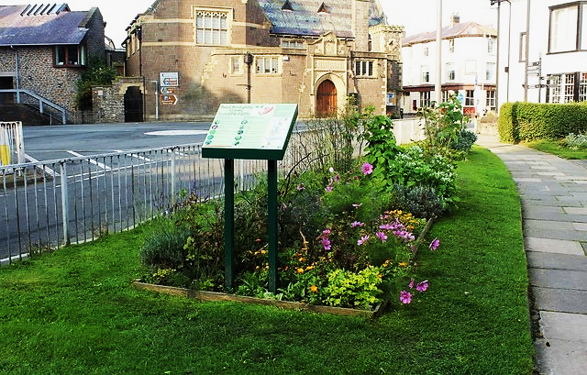
5
BiodiverCITIES
Is there room for this in your local town or city?
A business
called Incredible
Edible has a
group in Conwy
that has made
flower, herb,
fruit and
vegetable beds in
patches all over
the town.
Conwy, North Wales
Mayor of
Nottingham,
Council House,
NOTTINGHAM.
Notes:
Images
Microsoft Fluent Emoji
Unsplash
iStock
Canva
https://commons.wikimedia.org/wiki/File:Incredible_edible_-_geograph.org.uk_-_5552099.jpg
References
https://www.incredibleedible.org.uk/what-we-do/
https://www.nottinghamcity.gov.uk/your-council/about-the-council/councillors-and-leadership/the-lord-mayor-of-nottingham/

Slide 25
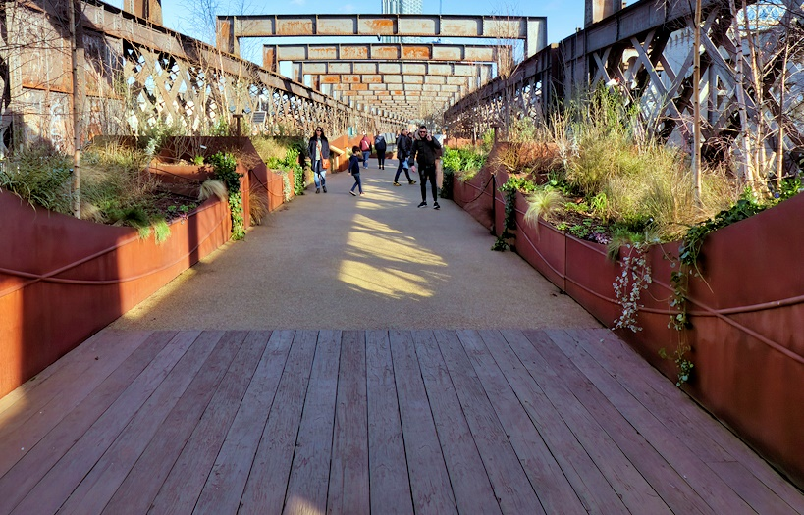
5
BiodiverCITIES
Is there room for this in your local town or city?
An unused
railway bridge
in Manchester
(Castlefield
Viaduct) has been
turned into a
city garden space
to increase
wildlife in the
city.
Manchester
North-West England
Mayor of London,
City Hall,
Kamal Chunchie Way,
LONDON.
Notes:
Images
Microsoft Fluent Emoji
Unsplash
iStock
Canva
https://commons.wikimedia.org/wiki/File:National_Trust_%27Sky_Park%27,_Castlefield_Viaduct,_Manchester_(geograph_7417617).jpg
References
https://www.nationaltrust.org.uk/visit/cheshire-greater-manchester/castlefield-viaduct
https://www.london.gov.uk/who-we-are/what-mayor-does/contact-city-hall-or-mayor

Slide 26
5
BiodiverCITIES
Newcastle, North-East England
Is there room for this in your local town or city?
In Newcastle,
there is a living
wall of plants
growing on the
side of a
supermarket
building to
increase plant
and insect life.
Mayor of Exeter,
Civic Centre,
Paris Street,
EXETER.
Notes:
Images
Microsoft Fluent Emoji
Unsplash
iStock
https://upload.wikimedia.org/wikipedia/commons/c/cd/Living_wall_%2818653257555%29.jpg
References
https://www.chroniclelive.co.uk/news/north-east-news/newcastles-marks--spencer-store-8947375
https://exeter.gov.uk/council-and-democracy/contact-us/contact-us/

Slide 27
6
Reconnecting with nature
Individual reflection (3-4 mins)
On the next slide, you will see a tally chart with some different ways that you can encourage more wildlife in your school. Draw this on a whiteboard in the classroom or head outside to draw it on the playground using chalk…
Notes:
Images
Unsplash
Microsoft Office Icons
References
https://www.besa.org.uk/key-uk-education-statistics
https://www.eco-schools.org.uk/ten-topics/

Slide 28
6
Reconnecting with nature
Set up a bug hotel
Make recycled planters
Challenge
(2 mins)
If you go outside to make your tally chart, why not use sticks to share your vote?
Plant fruit and vegetables
Plant more wildflowers
Grow a living wall
Notes:
Images
Unsplash
References
https://www.besa.org.uk/key-uk-education-statistics
https://www.eco-schools.org.uk/ten-topics/

Slide 29
Now’s your chance to vote on: “Would you like more wildlife in your towns and cities?”
Yes
Yes, I think more wildlife in towns and cities can make the Earth healthier.
We should be more comfortable being around wildlife.
I would enjoy seeing greener towns and cities with more animals in them.
I think I would feel scared of wildlife in towns and cities.
Wildlife might cause problems in towns and cities.
I don’t like the look of plants growing in towns and cities.
No
Ready to join the national conversation?
Please click here to cast votes and share views on this topic. Your opinions will then be passed on to leaders and changemakers around the UK.

Slide 33
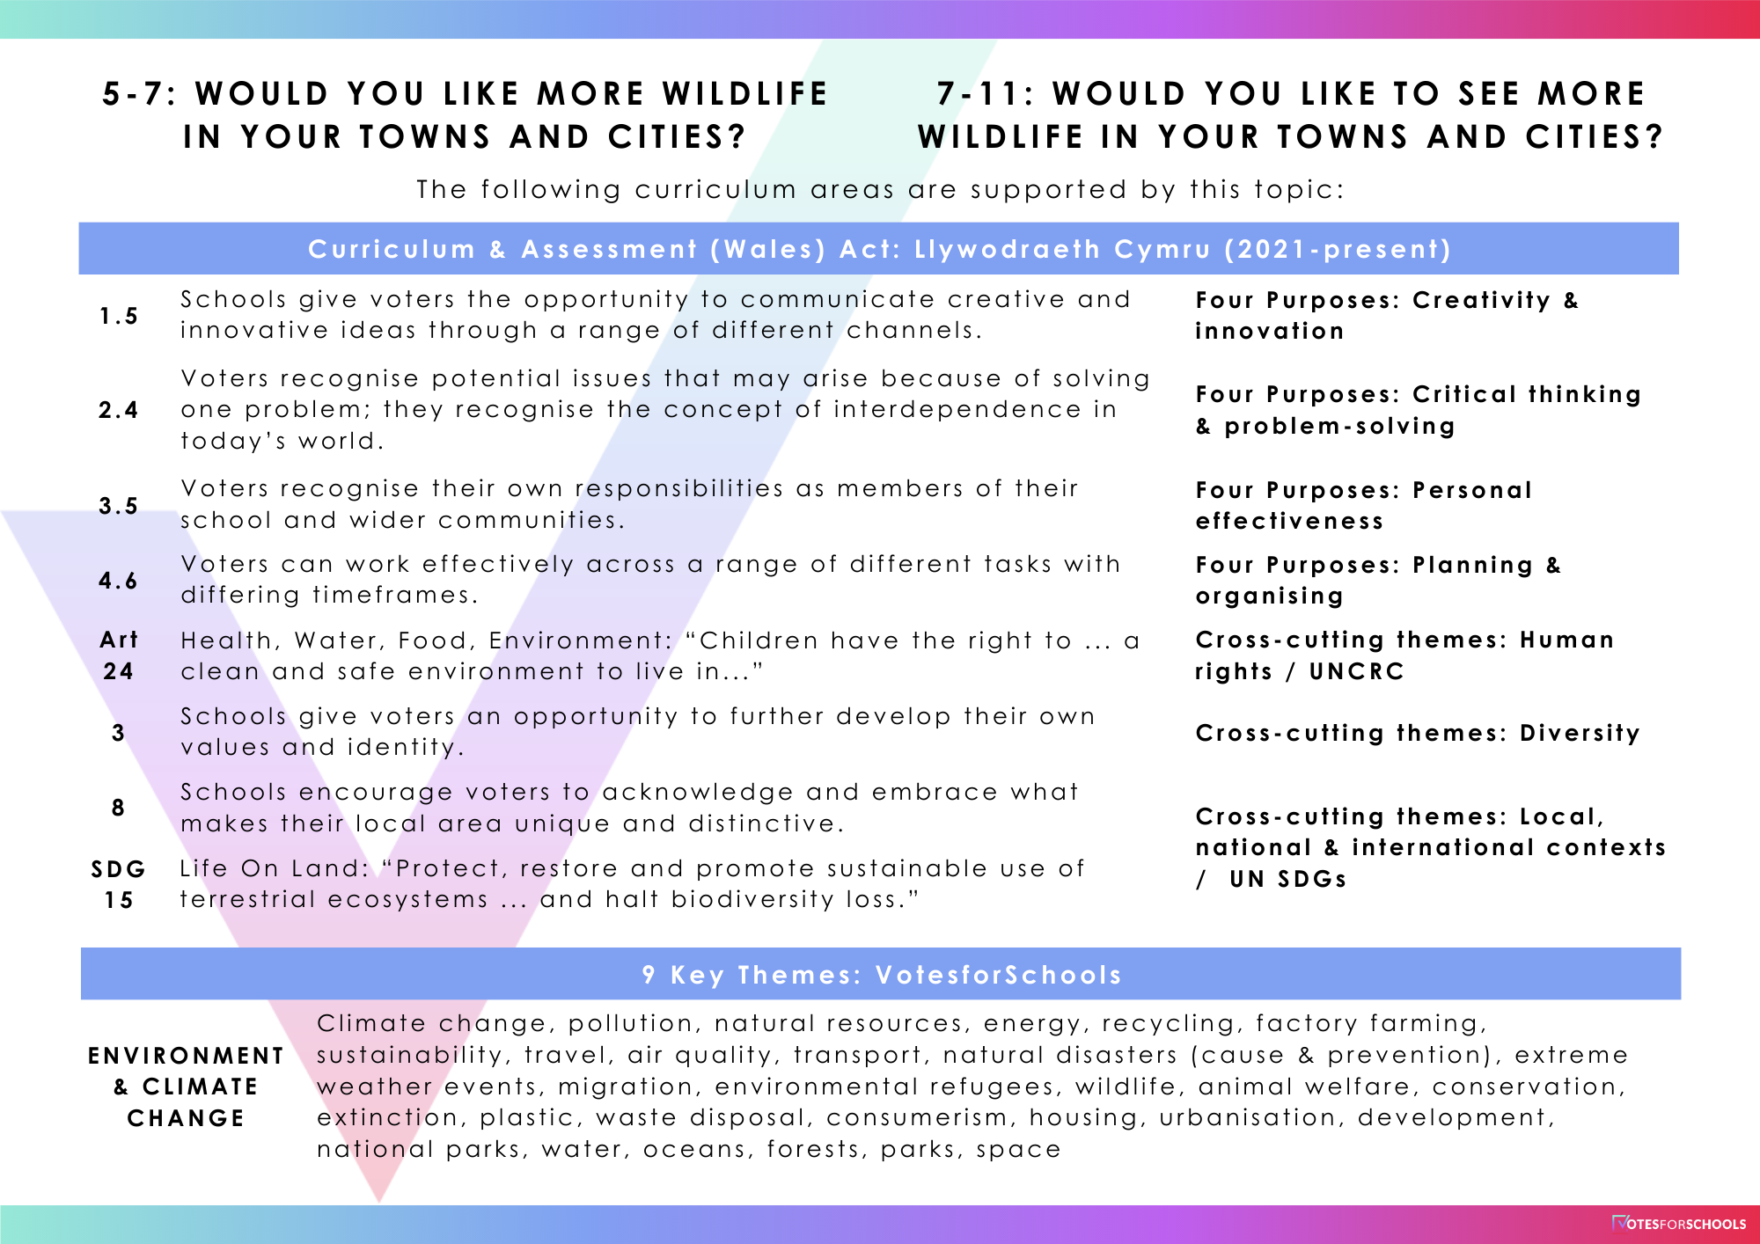
Notes:
Survey link: https://www.surveymonkey.com/r/VfS-Earth-Day-vote

